Slide 1
Object detection with integral image based extended set of Haar-like features and Adaboost algorithm

Slide 2

Integral image
Integral image of a pixel with coordinates of (x,y) is the sum of its neighbors to the upper left and defined as follows.
$$ii\left(x,y\right)=\sum_{x^{′}≤ x}{\sum_{y^{′}≤ y}{I\left(x^{′},y^{′}\right)}}$$
Mathematically speaking, unlike the original pixels’ gray level values that have many identical numbers in an image frame, their integral image values of pixels are quite different from each other. Therefore, integral image is very useful for unique feature extractions.

Slide 3
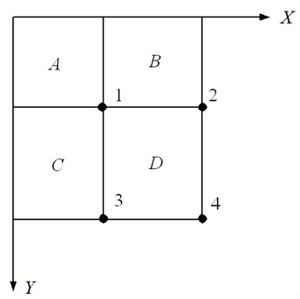


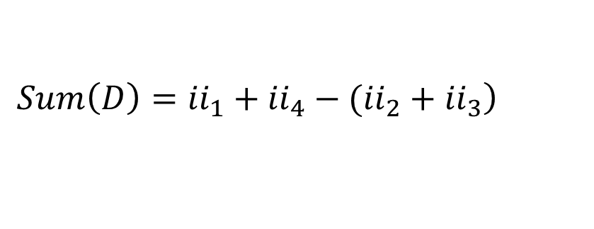
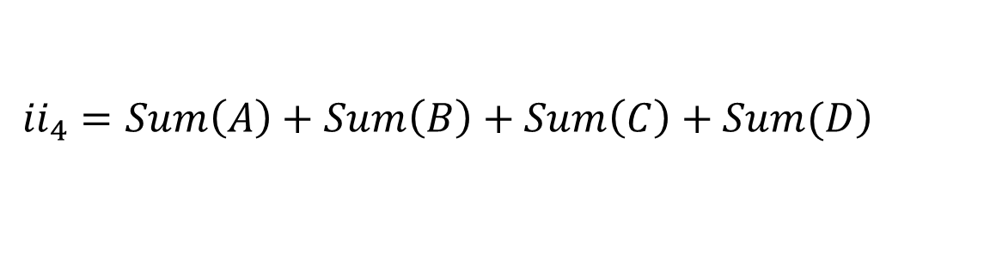
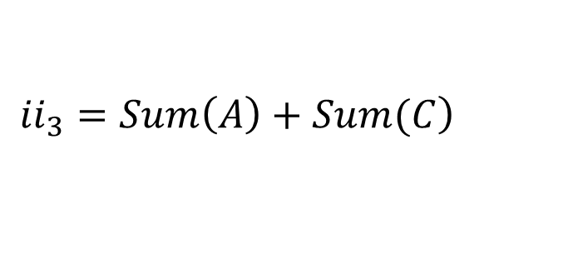
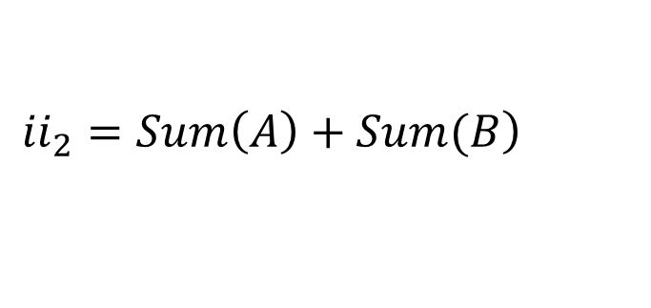

Integral image blocks
Based on Figure, the integral images of individual blocks can be computed as follows.
${ii}_{1}=Sum\left(A\right)$
$$\left.{ii}_{2}=Sum\left(A\right)+Sum(B\right)$$
$$\left.{ii}_{3}=Sum\left(A\right)+Sum(C\right)$$
$$\left.{ii}_{4}=Sum\left(A\right)+Sum\left(B\right)+Sum\left(C\right)+Sum(D\right)$$
$$\left.Sum\left(D\right)={ii}_{1}+{ii}_{4}−({ii}_{2}+{ii}_{3}\right)$$
$$Sum\left(C\right)={ii}_{3}{−ii}_{1}$$
$$Sum\left(B\right)={ii}_{2}{−ii}_{1}$$

Slide 4
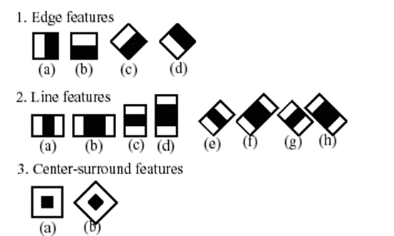
Extended harr-like rectangle features
Based on integral images, the following extended harr-like rectangle features which are sensitive to the presence of edges, bars, and other simple image structure in the following figure are used. Each haar-like feature is a single value obtained by subtracting sum of pixels under the white rectangle from sum of pixels under the black rectangle.

Slide 5
Object classifier training with AdaBoost method
AdaBoost, short for Adaptive Boosting, is an iterative method to improve accuracy of machine learning.
Boosting is an ensemble technique (a.k.a. committee method).
A weak classifier with the least error rate is selected in every iteration and its corresponded weighting is calculated based on its error rate.
When the iterations finish, a strong classifier of highly accurate prediction is created by combining every product of weak learner and its weighting.

Slide 6
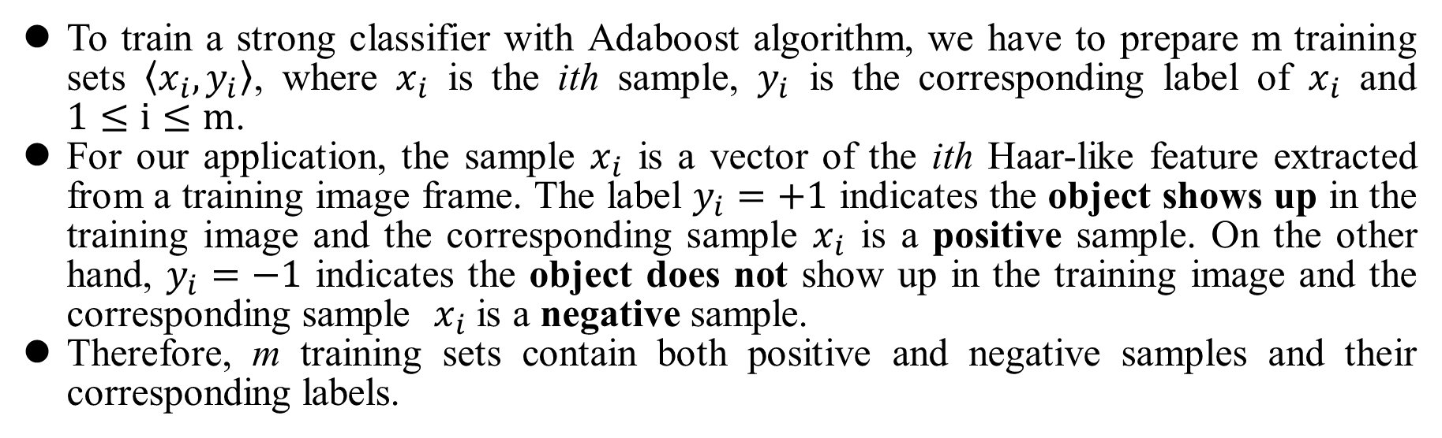
Preparing training simples for Adaboost
To train a strong classifier with Adaboost algorithm, we have to prepare m training sets $〈x_{i},y_{i}〉$, where $x_{i}$ is the ith sample, $y_{i}$ is the corresponding label of $x_{i}$ and $1≤i≤m$.
For our application, the sample $x_{i}$ is a vector of the ith Haar-like feature extracted from a training image frame. The label $y_{i}=+1$ indicates the object shows up in the training image and the corresponding sample $x_{i}$ is a positive sample. On the other hand, $y_{i}=−1$ indicates the object does not show up in the training image and the corresponding sample $x_{i}$ is a negative sample.
Therefore, m training sets contain both positive and negative samples and their corresponding labels.

Slide 7
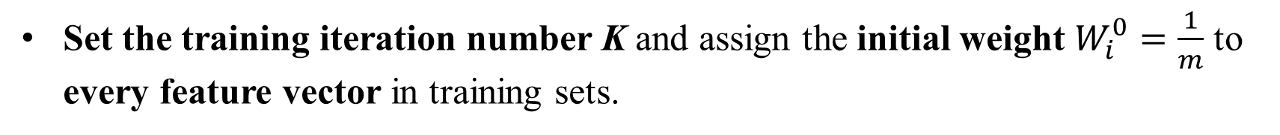

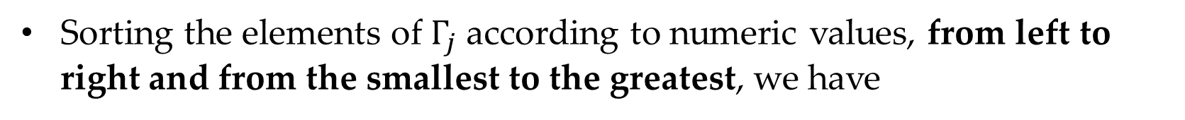
Adaptive Boosting training iterations
Set the training iteration number K and assign the initial weight $W_{i}^{0}=\frac{1}{m}$ to every feature vector in training sets.
Collecting the jth element from every n×1 Haar-like feature vector $x_{i}$ in the m training sets to form m new sets, we have
$$Γ_{j}=\left\{x_{i\left(j\right)}|∀i∈\left\{1,2,…,m\right\}, j∈\left\{1,2,…,n\right\}\right\}$$
Sorting the elements of $Γ_{j}$ according to numeric values, from left to right and from the smallest to the greatest, we have
$$V_{j}=〈v_{1\left(j\right)},v_{2\left(j\right)},…,v_{m\left(j\right)} 〉$$

Slide 8
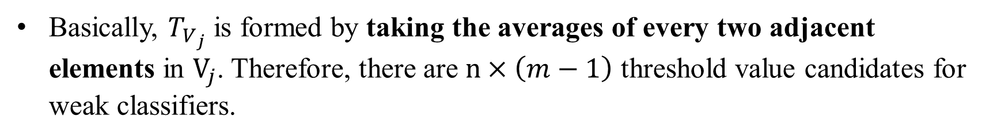
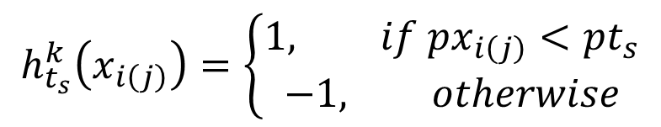
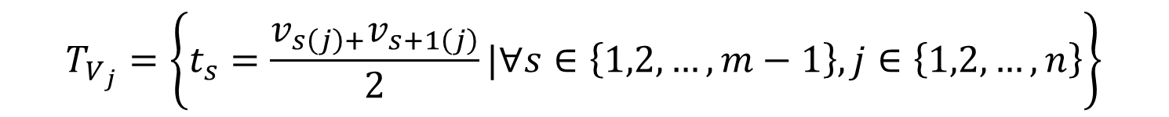
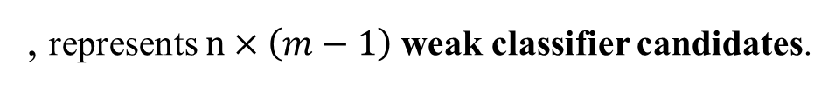
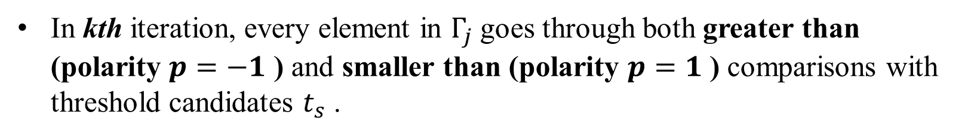
The threshold value candidate set for the jth element of Haar-like feature vectors is calculated as follows.
$$T_{V_{j}}=\left\{t_{s}=\frac{v_{s\left(j\right)+}v_{s+1\left(j\right)}}{2}|∀s∈\left\{1,2,…,m−1\right\}, j∈\left\{1,2,…,n\right\}\right\}$$
Basically, $T_{V_{j}}$ is formed by taking the averages of every two adjacent elements in $V_{j}$. Therefore, there are $n×\left(m−1\right)$ threshold value candidates for weak classifiers.
In kth iteration, every element in $Γ_{j}$ goes through both greater than (polarity $p=−1$ ) and smaller than (polarity $p=1$ ) comparisons with threshold candidates $t_{s}$ .
$$R_{t_{s},Γ_{j}}^{k}=〈h_{t_{s}}^{k}\left(x_{i\left(j\right)}\right)|∀x_{i\left(j\right)}∈Γ_{j},∀x∈\left\{1,2,…,m\right\},j∈\left\{1,2,…,n\right\}〉$$
$$h_{t_{s}}^{k}\left(x_{i\left(j\right)}\right)=\left\{\begin{matrix}1, if px_{i\left(j\right)}<pt_{s} \\ −1, otherwise\end{matrix}\right.$$
, represents $n×\left(m−1\right)$weak classifier candidates.

Slide 9
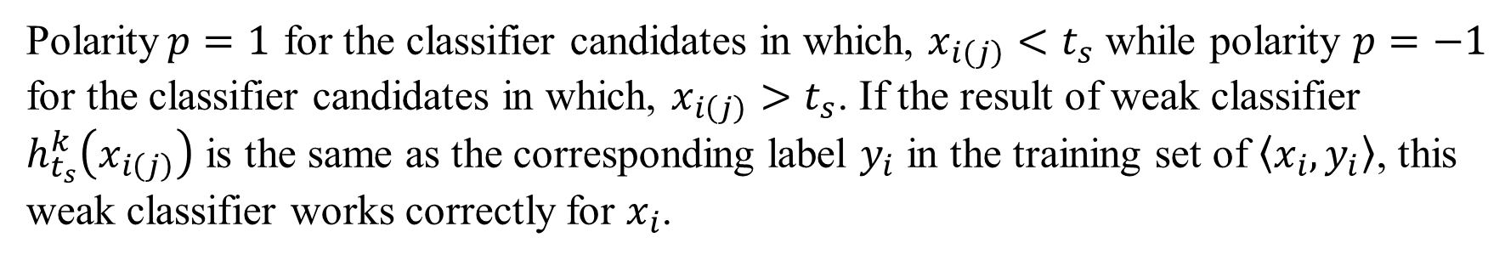
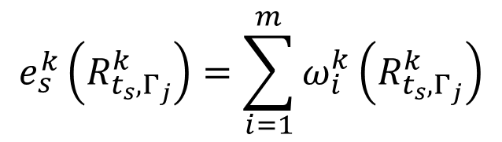
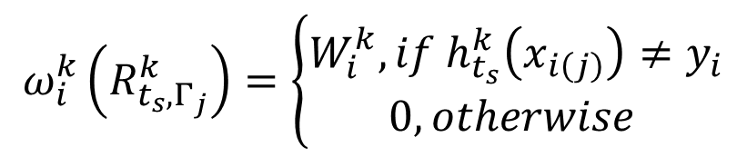
Each weak classifier has three associated variables. They are threshold $t_{s}$, polarity $p$ and weight $α^{k}$ used in the final strong classification by AdaBoost.
Polarity$p=1$ for the classifier candidates in which, $x_{i\left(j\right)}<t_{s}$ while polarity $p=−1$ for the classifier candidates in which, $x_{i\left(j\right)}>t_{s}$. If the result of weak classifier $h_{t_{s}}^{k}\left(x_{i\left(j\right)}\right)$ is the same as the corresponding label $y_{i}$ in the training set of $〈x_{i},y_{i}〉$, this weak classifier works correctly for $x_{i}$.
Otherwise, it does not and error occurs. In every training iteration, the error rates $ε_{j}^{k}$ of classifier candidates are calculated with the following equations.
$$ω_{i}^{k}\left(R_{t_{s},Γ_{j}}^{k}\right)=\left\{\begin{matrix}W_{i}^{k}, if h_{t_{s}}^{k}\left(x_{i\left(j\right)}\right)≠y_{i} \\ 0, otherwise \end{matrix}\right.$$
, comparison fails and error occurs.
$$e_{s}^{k}\left(R_{t_{s},Γ_{j}}^{k}\right)=\sum_{i=1}^{m}{ω_{i}^{k}\left(R_{t_{s},Γ_{j}}^{k}\right)}$$
$$ε_{j}^{k}=\left\{e_{s}^{k}\left(R_{t_{s},Γ_{j}}^{k}\right)|∀s∈\left\{1,2,…,m−1\right\},∀t_{s}∈Γ_{V_{j}}\right\}$$

Slide 10
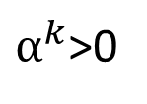
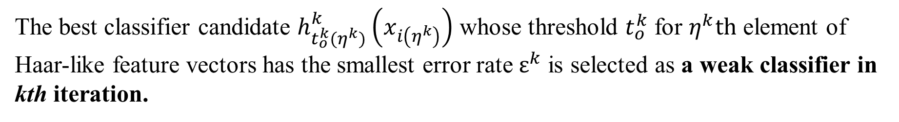
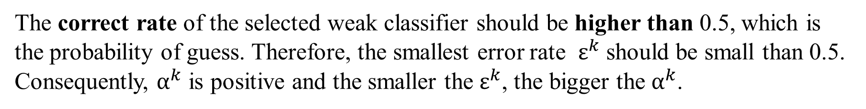
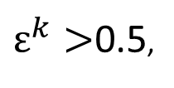
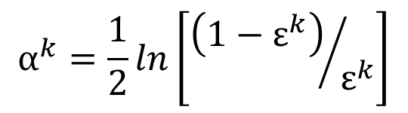
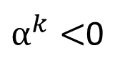
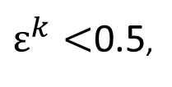
The best classifier candidate $h_{t_{o}^{k}(η^{k})}^{k}\left(x_{i\left(η^{k}\right)}\right)$ whose threshold $t_{o}^{k}$ for $η^{k}th$ element of Haar-like feature vectors has the smallest error rate $ε^{k}$ is selected as a weak classifier in kth iteration.
In the kth iteration, the voting weight $α^{k}$ of selected weak classifier $h_{t_{o(η^{k})}^{k}}^{k}\left(x_{i\left(η^{k}\right)}\right)$
in the final strong classifier is based on the $ε^{k}$ and is calculated with the following equation.
$$α^{k}=\frac{1}{2}ln\left[{\left(1−ε^{k}\right)}/{ε^{k}}\right]$$
$α^{k}$>0
when
$ε^{k}<$0.5,
$α^{k}<$0
when
$ε^{k}>$0.5,
The correct rate of the selected weak classifier should be higher than 0.5, which is the probability of guess. Therefore, the smallest error rate $ε^{k}$ should be small than 0.5. Consequently, $α^{k}$ is positive and the smaller the $ε^{k}$, the bigger the $α^{k}$.
In the other word, the weak classifiers with smaller error rate are more important
in final strong classifier.
In every iteration, the weight of m feature vectors are updated according to $α^{k}$.

Slide 11
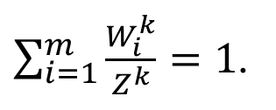

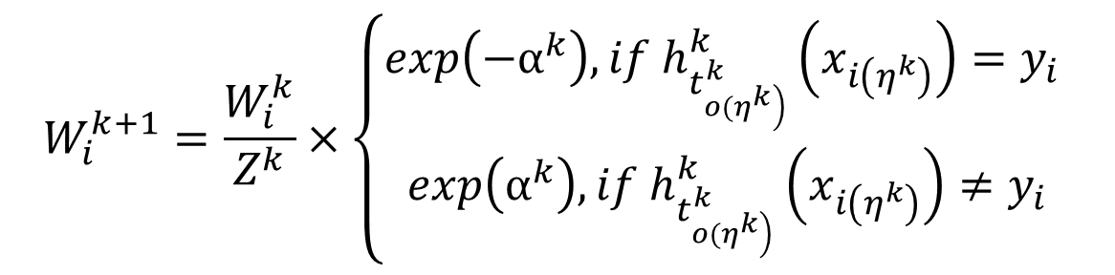
The normalization factor, namely, the summation of weights of feature vectors is defined as follows.
$Z^{k}=\sum_{i=1}^{m}{W_{i}^{k}}$,
$\sum_{i=1}^{m}{\frac{W_{i}^{k}}{Z^{k}}}=1$.
such that
Then the normalized weight updates are
$$W_{i}^{k+1}=\frac{W_{i}^{k}}{Z^{k}}×\left\{\begin{matrix}exp\left(−α^{k}\right), if h_{t_{\left.o(η^{k}\right)}^{k}}^{k}\left(x_{i\left(η^{k}\right)}\right)=y_{i} \\ exp\left(α^{k}\right), if h_{t_{\left.o(η^{k}\right)}^{k}}^{k}\left(x_{i\left(η^{k}\right)}\right)≠y_{i}\end{matrix}\right.$$
Therefore, in next training iteration, the weights of correct classifiers are decreased while the weights of incorrect classifiers are increased. Training samples misclassified by a previous weak learner are given more emphasis at future rounds.

Slide 12
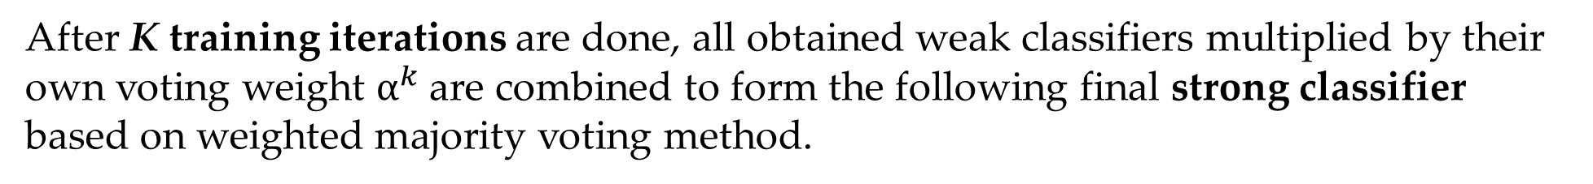
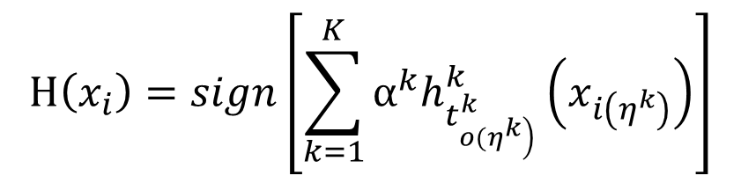
After K training iterations are done, all obtained weak classifiers multiplied by their
own voting weight $α^{k}$are combined to form the following final strong classifier based on weighted majority voting method.
$$H\left(x_{i}\right)=sign\left[\sum_{k=1}^{K}{α^{k}h_{t_{\left.o(η^{k}\right)}^{k}}^{k}\left(x_{i\left(η^{k}\right)}\right)}\right]$$
Therefore, final strong classifier is combination of the weak ones, weighted according to error they had.

Slide 13
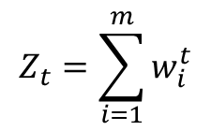
$$Z_{t}=\sum_{i=1}^{m}{w_{i}^{t}}$$

Slide 14


Adaboosting Example
For $I\left(x<2.5\right)$ , x=6, x=7 and x=8 are not correctly classified.
Notation of $p_{i}=w_{i}$ in this handout
Substituting x=6, x=7 and x=8 into the first stage classifier,
will all get -1. However, for x=6, x=7 and x=8, the corresponding y are 1.
$$I\left(x<2.5\right)$$

Slide 15
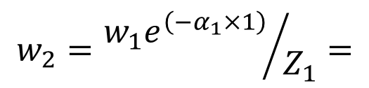
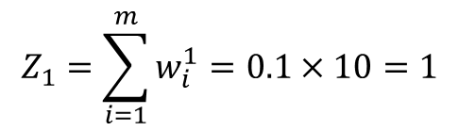
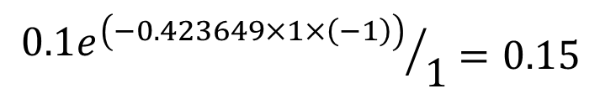
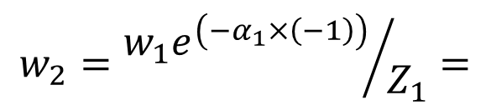
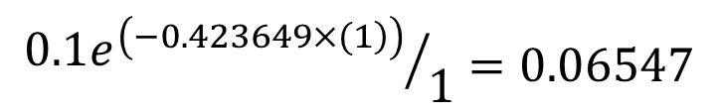
Voting weight of stage 1:
% Matlab to calculate alpha
e=0.3
a=0.5*log((1-e)/e)
Classifier of the first stage:
$$sign\left(H\left(x\right))=sign(0.423649I\left(x<2.5\right)\right)$$
Weighting update:
$$Z_{1}=\sum_{i=1}^{m}{w_{i}^{1}=0.1×10=1}$$
For the correct one:
$$w_{2}={w_{1}e^{\left(−α_{1}×1\right)}}/{Z_{1}}=$$
$${0.1e^{\left(\left.−0.423649×(1\right)\right)}}/1=0.06547$$
(decreased)
For the incorrect one:
$$w_{2}={w_{1}e^{\left(−α_{1}×\left(−1\right)\right)}}/{Z_{1}}=$$
$${0.1e^{\left(−0.423649×1×\left(−1\right)\right)}}/1=0.15$$
(increased)

Slide 16
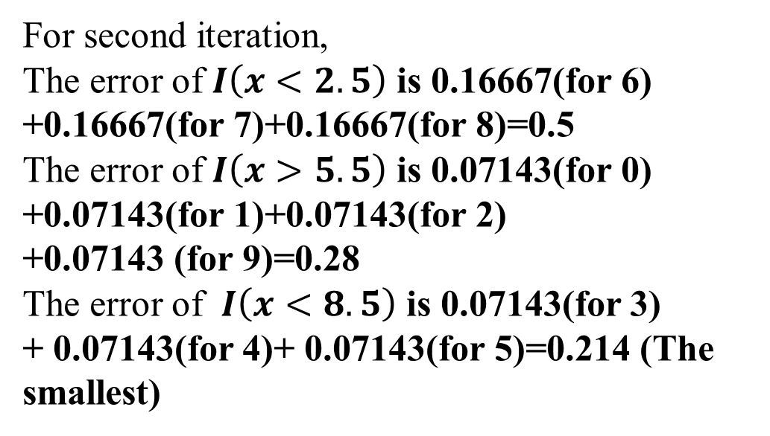
For second iteration,
The error of $I\left(x<2.5\right)$ is 0.16667(for 6) +0.16667(for 7)+0.16667(for 8)=0.5
The error of $I\left(x>5.5\right)$ is 0.07143(for 0) +0.07143(for 1)+0.07143(for 2)
+0.07143 (for 9)=0.28
The error of $I\left(x<8.5\right)$ is 0.07143(for 3)
+ 0.07143(for 4)+ 0.07143(for 5)=0.214 (The smallest)

Slide 17
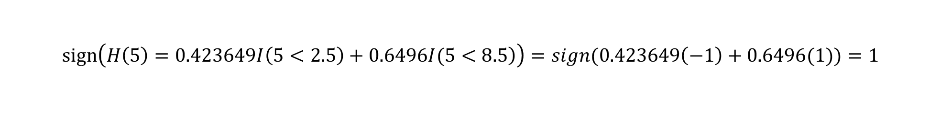
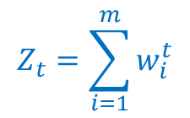
Classifier of the second stage:
$$sign\left(\left.H\left(x\right))=sign(0.423649I\left(x<2.5\right)+0.6496I(x<8.5\right)\right)$$
However, Substituting x=3, x=4 and x=5 into the second stage classifier, will all get 1. However, for x=3, x=4 and x=5, the corresponding y are -1. Therefore, this classifier still cannot work for all of x. For example,
$$sign\left(\left.H\left(5\right)=0.423649I\left(5<2.5\right)+0.6496I(5<8.5\right)\right)=sign(0.423649\left(−1\right)+0.6496(1))=1$$
$$Z_{t}=\sum_{i=1}^{m}{w_{i}^{t}}$$

Slide 18
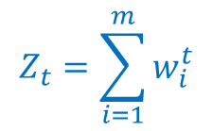
$$Z_{t}=\sum_{i=1}^{m}{w_{i}^{t}}$$
Re-compute weight:

Slide 19
Classifier of the third stage (The strong classifier):
$$sign\left(\left.H\left(x\right))=sign(0.423649I\left(x<2.5\right)+0.6496I\left(x<8.5\right)+0.752I(x>5.5\right)\right)$$
Substitute all x=0, 1, 2, 3, 4, 5, 6, 7, 8, 9 into the third stage classifier will get the same number as their corresponding y. Therefore, there is no mistake anymore. The third stage Classifier can 100% work for all x. The strong classifier is obtained.

Slide 20
$$sign\left(\left.H\left(0\right))=sign(0.423649I\left(0<2.5\right)+0.6496I\left(0<8.5\right)+0.752I(0>5.5\right)\right)=sign\left(0.423649\left(1\right)+0.6496\left(1\right)+0.752\left(−1\right)\right)=1$$
$$sign\left(\left.H\left(1\right))=sign(0.423649I\left(1<2.5\right)+0.6496I\left(1<8.5\right)+0.752I(1>5.5\right)\right)=sign\left(0.423649\left(1\right)+0.6496\left(1\right)+0.752\left(−1\right)\right)=1$$
$$sign\left(\left.H\left(4\right))=sign(0.423649I\left(4<2.5\right)+0.6496I\left(4<8.5\right)+0.752I(4>5.5\right)\right)=sign\left(0.423649\left(−1\right)+0.6496\left(1\right)+0.752\left(−1\right)\right)=−1$$
$$sign\left(\left.H\left(7\right))=sign(0.423649I\left(7<2.5\right)+0.6496I\left(7<8.5\right)+0.752I(7>5.5\right)\right)=sign\left(0.423649\left(−1\right)+0.6496\left(1\right)+0.752\left(1\right)\right)=1$$
$$sign\left(\left.H\left(9\right))=sign(0.423649I\left(9<2.5\right)+0.6496I\left(9<8.5\right)+0.752I(9>5.5\right)\right)=sign\left(0.423649\left(−1\right)+0.6496\left(−1\right)+0.752\left(1\right)\right)=−1$$

Slide 21
HW: Design a strong Adaboost classifier for the following training set
index | 0 | 1 | 2 | 3 | 4 | 5
X value | 1 | 3 | 9 | 11
Y value | 1 | -1 | 1 | -1

